Slide 1

Automated robust first peak detection in a time signal using computational intelligence
Computational Intelligence
Prof. Andreas Pech
Presented by
md.shishir@stud.fra-uas.de 1344477 maruf.hossain@stud.fra-uas.de 1390272 khan.rahman@stud.fra-uas.de 1347995 akash.saha@stud.fra-uas.de 1345829

Slide 2
Overview
Introduction
Signal Processing Approach (Library and Functions)
First peak detection in Signal Processing Approach
Machine Learning Approach(Library and Functions)
First peak detection in Machine Learning Approach
Noise filtering
GUI
Output

Slide 3
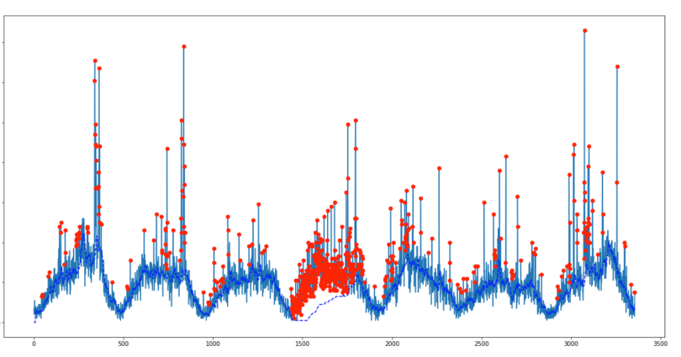
Introduction
Peak detection is a fundamental step in scientific data analysis, allowing us to pinpoint critical features such as positions, heights, widths, and areas within datasets
For signal processing applications using computational intelligence, peak detection is an important step.

Slide 4

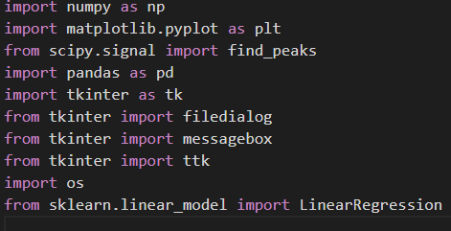
Signal Processing Approach (Library and Functions)
scipy.signal.find_peaks
This function takes a 1-D array and finds all local maxima by simple comparison of neighboring values. Optionally, a subset of these peaks can be selected by specifying conditions for a peak’s properties.

Slide 5
Signal Processing Approach (Library and Functions)
In our model, for detecting the first peak of the signal we used SciPy library.
SciPy: Vital for scientific & numerical computing.
Significance:
Rich functionality in signal processing, optimization, stats.
Efficient & optimized for high-performance computing.
Seamless integration with NumPy.
NumPy Dependency:
Built on NumPy for fast array manipulation.
SciPy functions operate on NumPy arrays.

Slide 6

Signal Processing Approach (Library and Functions)
pandas as pd
Handling Data: Pandas is a versatile Python library used for data manipulation and analysis.
Data Conversion: Pandas plays a pivotal role in converting data values to the float64 data type, ensuring data consistency and compatibility for numerical operations.

Slide 7
Signal Processing Approach (Library and Functions)
tkinter as tk
The tkinter package (“Tk interface”) is the standard Python interface to the Tcl/Tk GUI toolkit.
tkinter import filedialog
This function offers a dialog that can be used while working with files.
We used this package to create Graphical User Interface for uploading our test file.

Slide 8
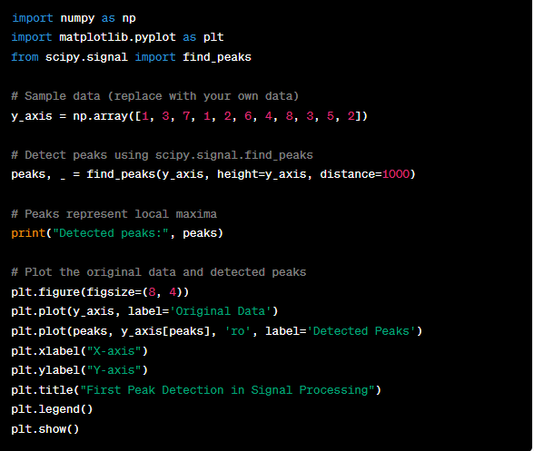
First Peak Detection in Signal Processing Approach

Slide 9
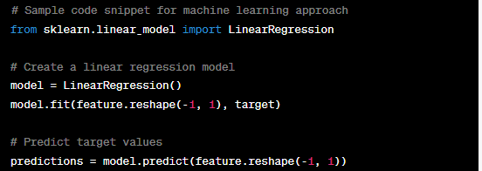
Machine Learning Approach (Library and Functions)
Application of Machine Learning: Machine Learning plays a significant role in peak detection, offering robust and automated methods for identifying peaks in data.
Scikit-learn Modules: Scikit-learn (Sklearn) is a powerful library for Machine Learning in Python. We leverage Sklearn's modules for peak detection and predictive modeling.

Slide 10
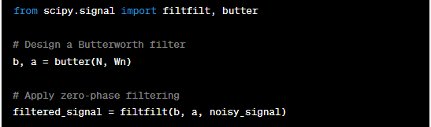
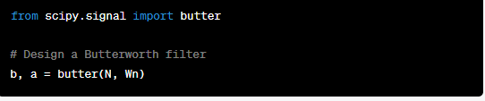
Noise Handling
Concept of Noise Filtering: Noise filtering is a crucial step in data processing, aiming to reduce or eliminate unwanted variations or interference (noise) from signals, enhancing the quality of data for analysis.
scipy.signal.butter
Scipy Functions: Scipy offers valuable functions for noise filtering, including scipy.signal.filtfilt and scipy.signal.butter

Slide 11
GUI
For the input, we used a GUI in our model.
GUI Implementation: Our model features a Graphical User Interface (GUI) to facilitate user interaction and data input.
Tkinter: Tkinter, a Python library, plays a pivotal role in creating the GUI. It provides tools for designing windows, buttons, entry fields, and other essential GUI components.

Slide 12
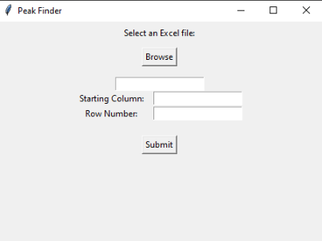
GUI

Slide 13
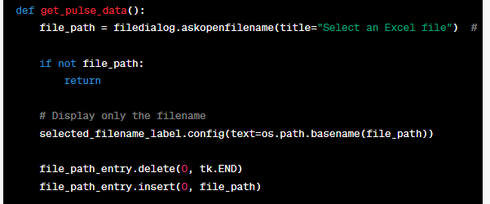
GUI
To enable file uploading in your provided code, the tkinter library is used in combination with the filedialog module. Specifically, the filedialog.askopenfilename function is used to open a file dialog that allows the user to browse and select a file from their local system.

Slide 14
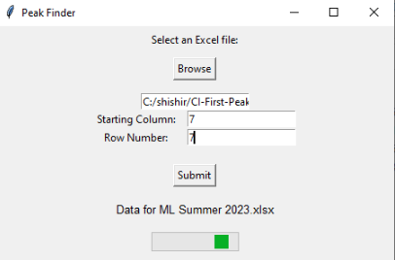
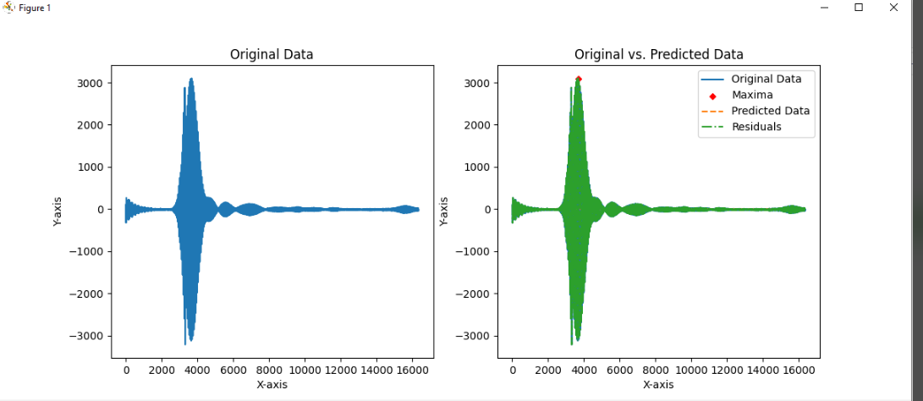
Output (first peak detection Data set one)

Slide 15
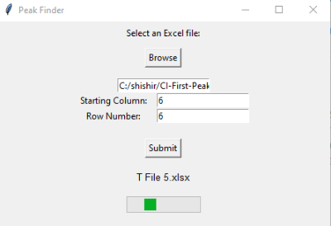
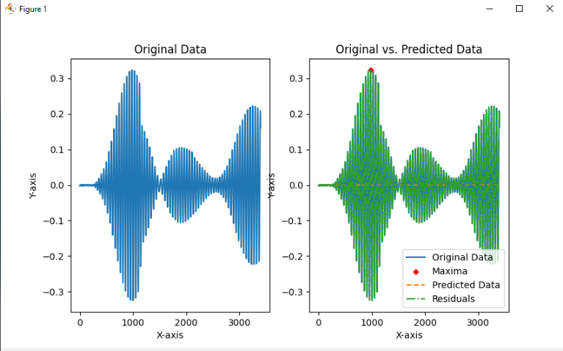
Output (first peak detection Data set two)

Slide 16
Question?

